Slide 1
Distribution of Possums in NSW
Spatial Distribution Pattern

Slide 2
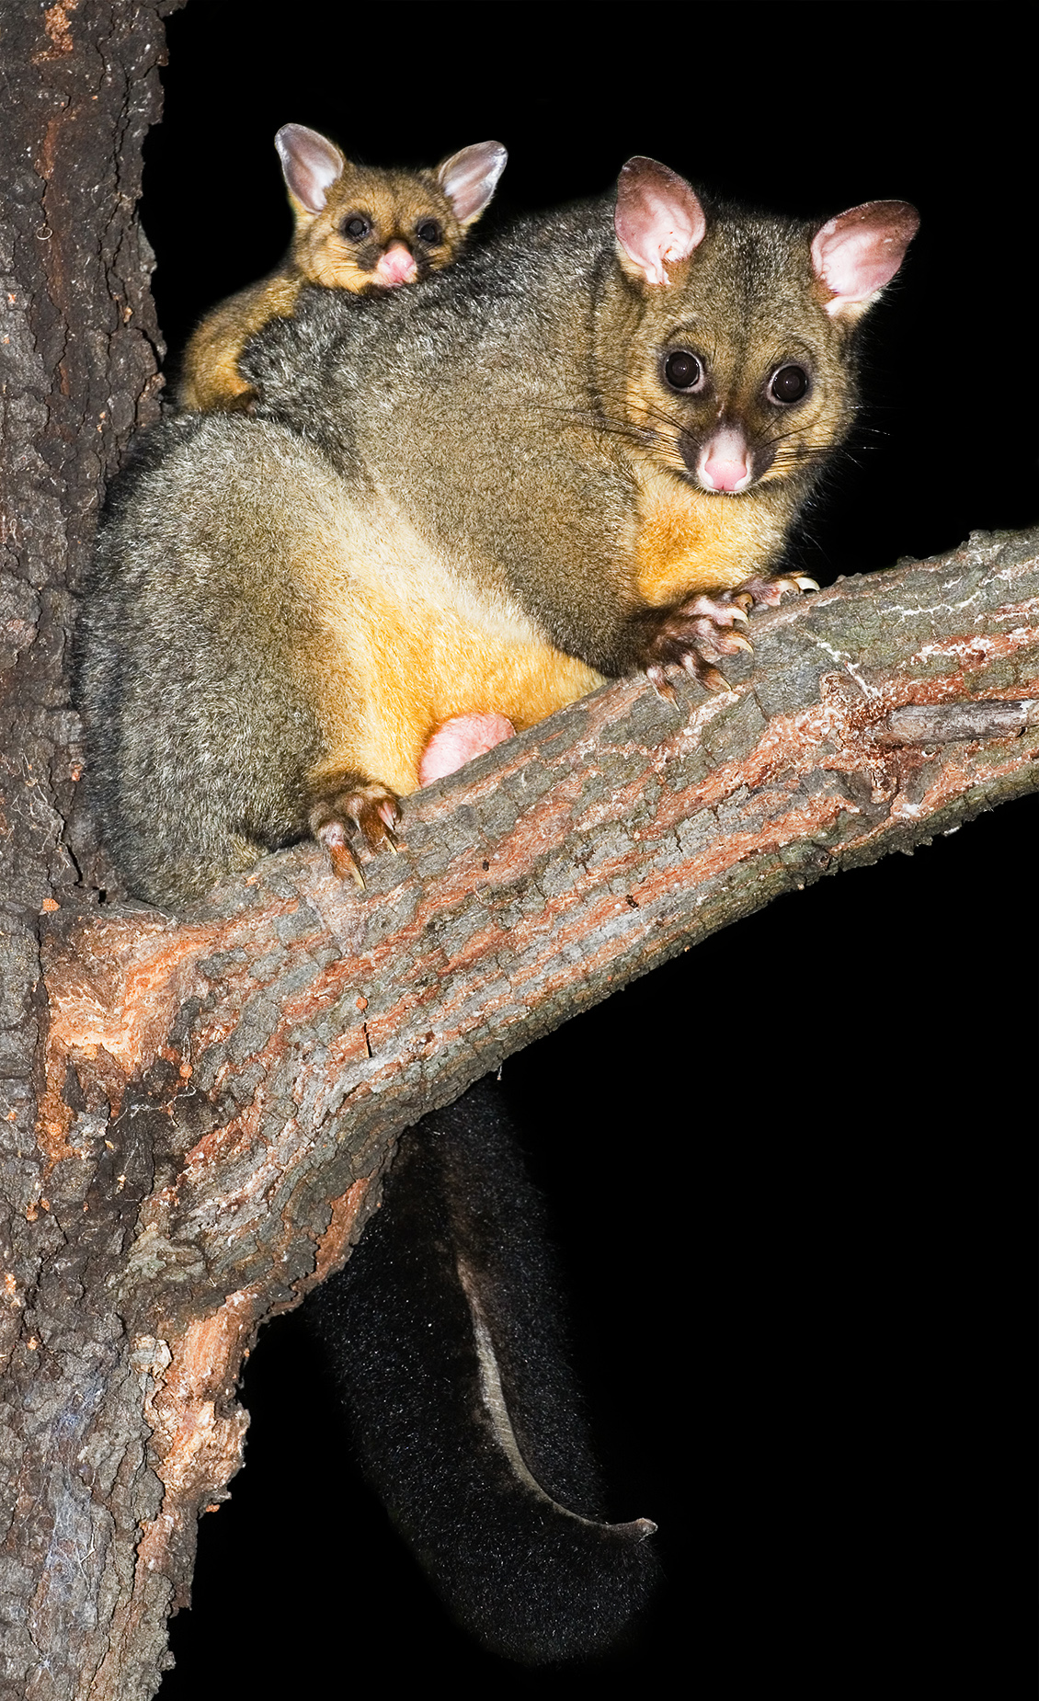
Current problematic and Background
Current problematic
The Brush-tailed possum is one of the best known Australian marsupial.
These animals are widely distributed and predominantly arboreal making them difficult to detect.
There are well settled into urban life, a lot of their occupancy is in private land. A reason of some concern for their well-being in the ‘wild’.
Background
In 2006, during a project for koalas, data for other 10 iconic species was taken though a community survey including the Brush-tailed data.
The data was collected though a map-based mail survey of rural and outer-urban New South Wales to determine the distribution of the 10 species.
Objective
“ Define an initial distribution (pattern) of the current population of possums in NSW”.
Null Hypothesis
What is the probability that the distribution of these features is occurring due to random chance?

Slide 3
Pseudocode (issues)
Start
Create a new script
Add a header, script name and purpose
Import Arcpy module and set workspace
Determine the data needed
Coordinates of the location of possums (Atlas Records txt file)
Create new layer using the XY coordinates
Set the spatial reference
Make a XY event layer
Copy the Features created in the new layer
Print the total of rows copy using the Get Count function
Add print “XY points uploaded and a temporary layer was created”
Perform Select by Attributes in the new layer
Make a Feature Layer to be used in the Selection by Attribute as this function only uses feature layers
Use Select by Attributes to subset the data to only Dan Lunney’s data survey (SQL exp)
Copy new feature class layer to make it permanent
Print total of rows in new feature class using the GetCount function
Delete temporal layer produce by Make Feature Layer
Add print “Select by Attribute completed”
Analysis of the distribution using Average Nearest Neighbor statistical method
Process ANN
Create a list of the ANN output values
Print the nearest neighbor index
Print the z-score of the nearest neighbor index
Print the p-value of the nearest neighbor index
Print the expected mean distance
Print the observed mean distance
Add print “Script has completed” to the script

Slide 4
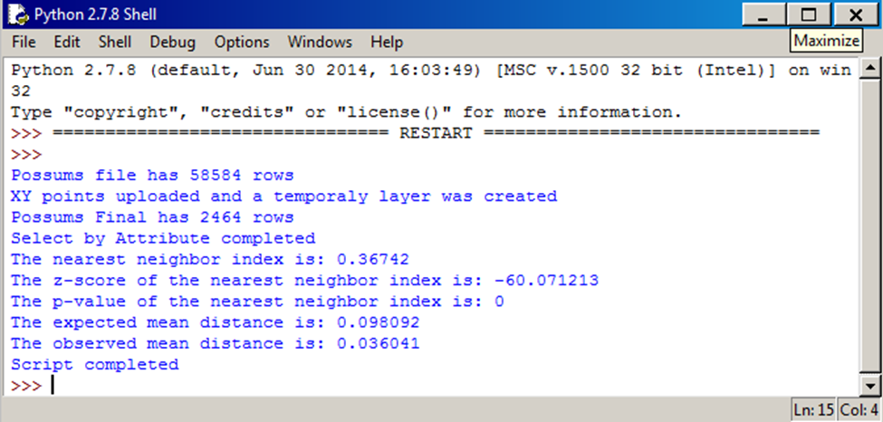
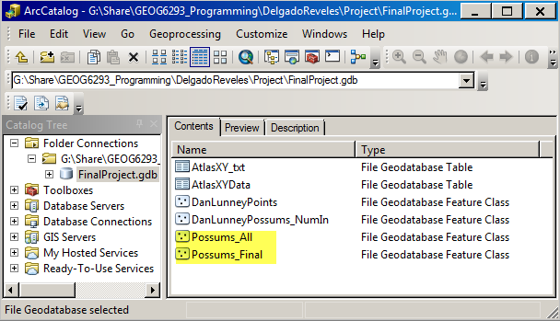
Script Results

Slide 5
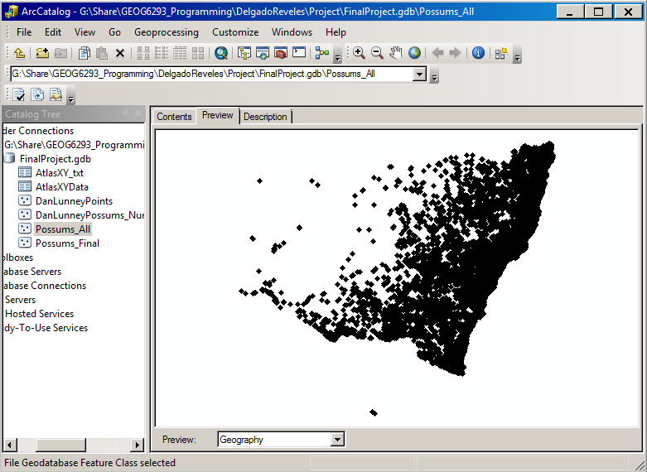
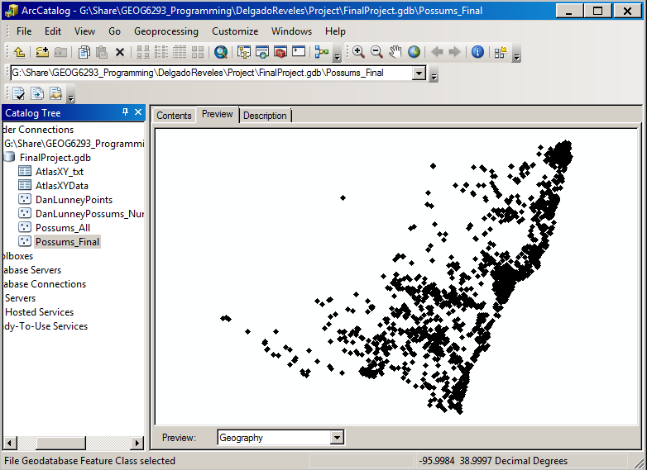
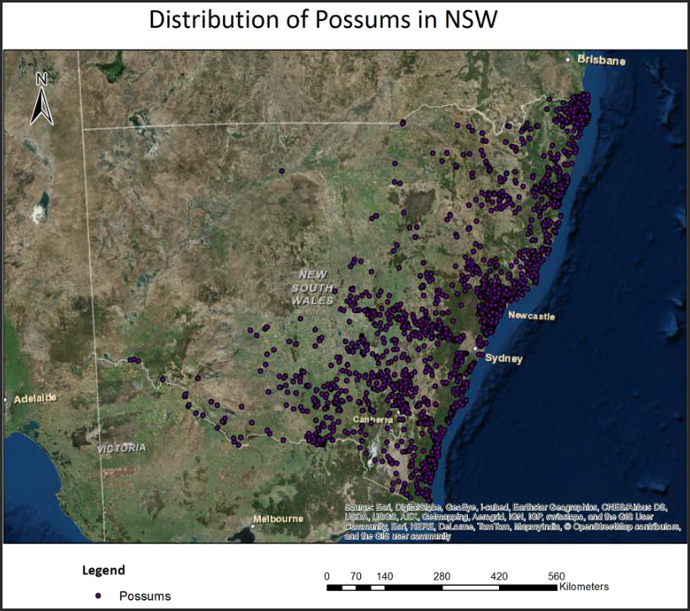
Distribution Map

Slide 6
Conclusions
The population of Possums is concentrated on the coast line of New South Wales.
The Distribution of the Possums is clustered.
Given the z-score -60.07, there is a less than 1% likelihood that this clustered pattern could be the result of random chance.

